Slide 1
Blood Donation Management System

Slide 2
Team Member And GitHub Link
Name:- Patil Darshana Mohandas Roll No:-128
https://github.com/DarshanaPatil2805/blood_donation_project
Name:- Patil Priya Rajendra Roll No:-145
https://github.com/PriyaPatil2001/blood_donation_project
Name:- Saitwal Sakshi Vivek Roll No:-164
https://github.com/saitwalsakshgit/blood_donation_project
Name:- Zope Manali Bhaskar Roll No:-201
https://github.com/Manali1Zope/blood_donation_project
Name:- Patil Divya Pramod Roll No:-130
https://github.com/patildiya/blood_donation_project

Slide 3
INTORDUCTION
The population of the world is multiplying with each coming year and so are the diseases and health issues. With an increase in the population there is an increase in the need of blood.
The growing population of the world results in a lot of potential blood donors. But in spite of this not more than 10% of the total world population participates in blood donation. With the growing population and the advancement in medical science the demand for blood has also increased.
Due to the lack of communication between the blood donors and the blood recipients, most of the patients in need of blood do not get blood on time and hence lose their lives. There is a dire need of synchronization between the blood donors and hospitals and the blood banks. This improper management of blood leads to wastage of the available blood inventory. Improper communication and synch
reconization between the blood banks and hospitals leads to wastage of the blood available. These problems can be dealt with by automating the existing manual blood bank management system. A high-end, efficient, highly available and scalable system has to be developed to bridge the gap between the donors and the recipients and to reduce the efforts required to search for blood requirements.

Slide 4
PROPOSED SYSTEM
The proposed system (Blood Donation Management System) is designed to help the Blood Bank administrator to meet the demand of Blood by sending and/or serving the request for Blood as and when required. Proposed system gives the procedural approach of how to bridge the gap between Recipient, Donor, and Blood Banks. Recipient can check the availability of blood of all blood groups in all the registered blood banks available in the system so that request is not sent to a blood bank which is deficient of the required blood

Slide 5
OVEVIEW
The Blood Bank Management System which we have implemented contain following things:-
Information about Blood groups and Health Tips.
Available Blood sample
Register
Login

Slide 6
TECHNOLOGIES USED
Front end as: Sublime Text 3
Back end as: MySQL
Database: MySQL
Querying language: Sql
Forms: Html , css ,javascript

Slide 7
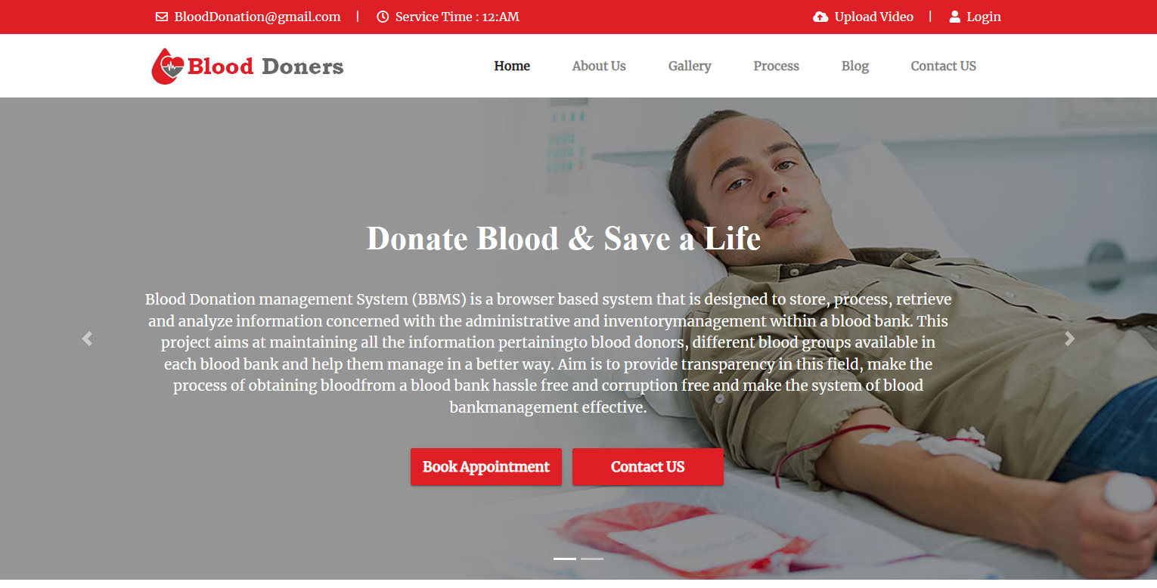
Screenshots

Slide 8
CONCLUSION
Technology is introducing new innovations day by day, thus reducing the time required to do things. The proposed system can be used to reduce the time required to deliver required blood to the needy in cases of emergency

